Slide 1
Wireless Communications:
Principles and Practice
2nd Edition
T.S. Rappaport
Chapter 10: Wireless Networking

Slide 2
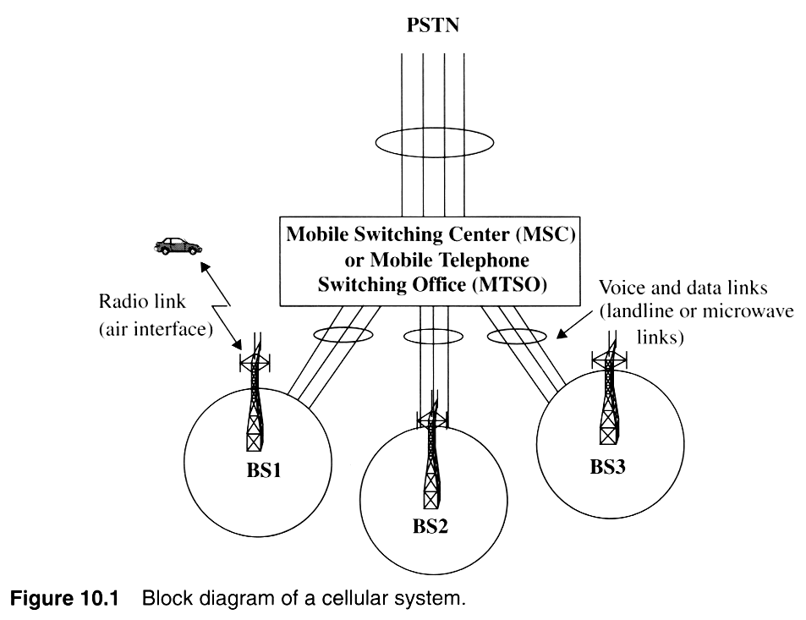

Slide 3
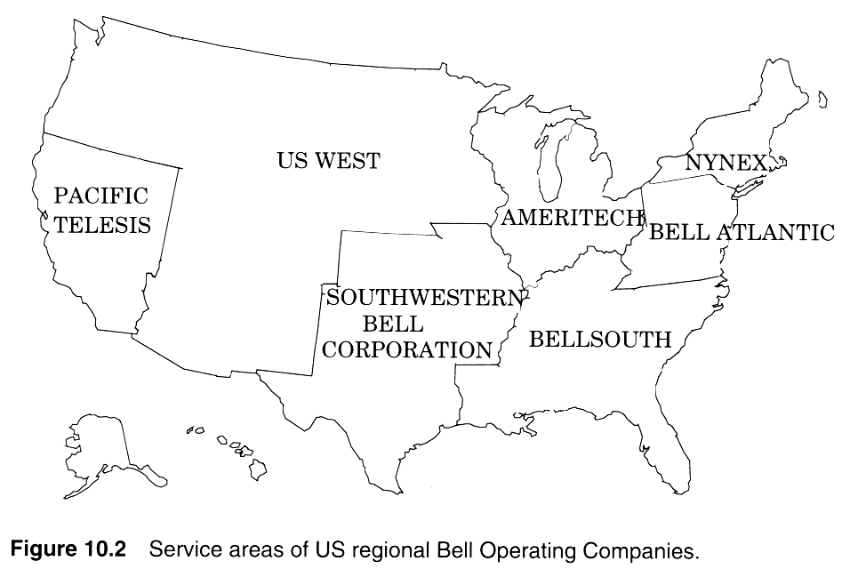
Notes:
Fig. 2.11

Slide 4
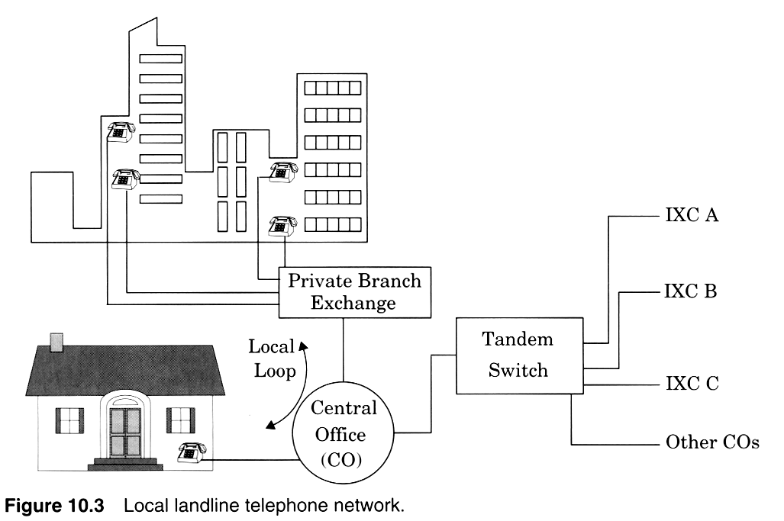
Notes:
Fig. 3.2

Slide 5
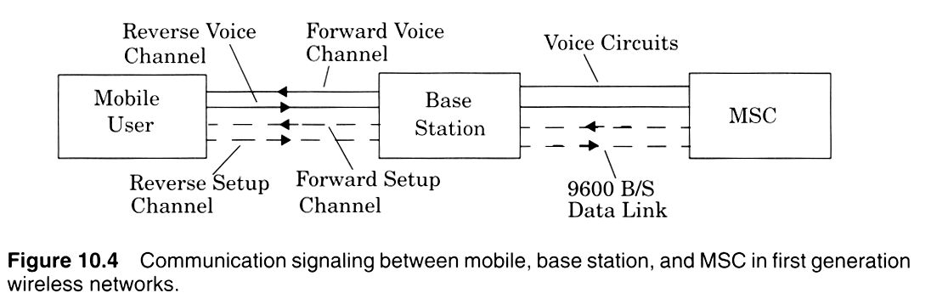

Slide 6
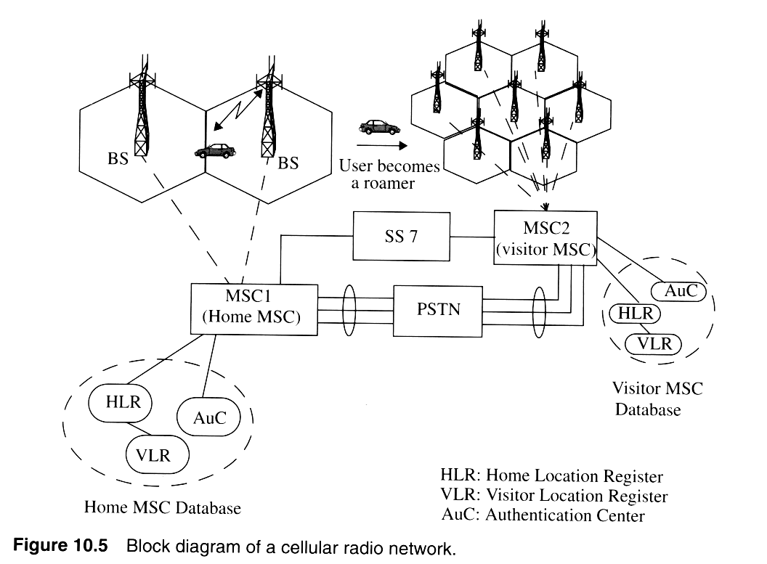
Notes:
Fig. 2.3

Slide 7
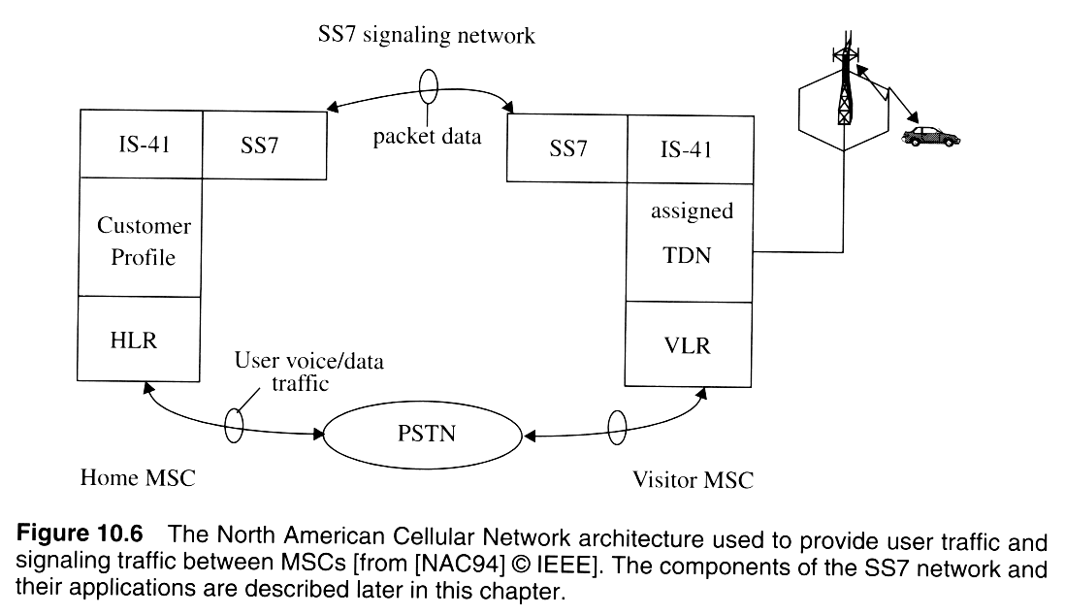

Slide 8
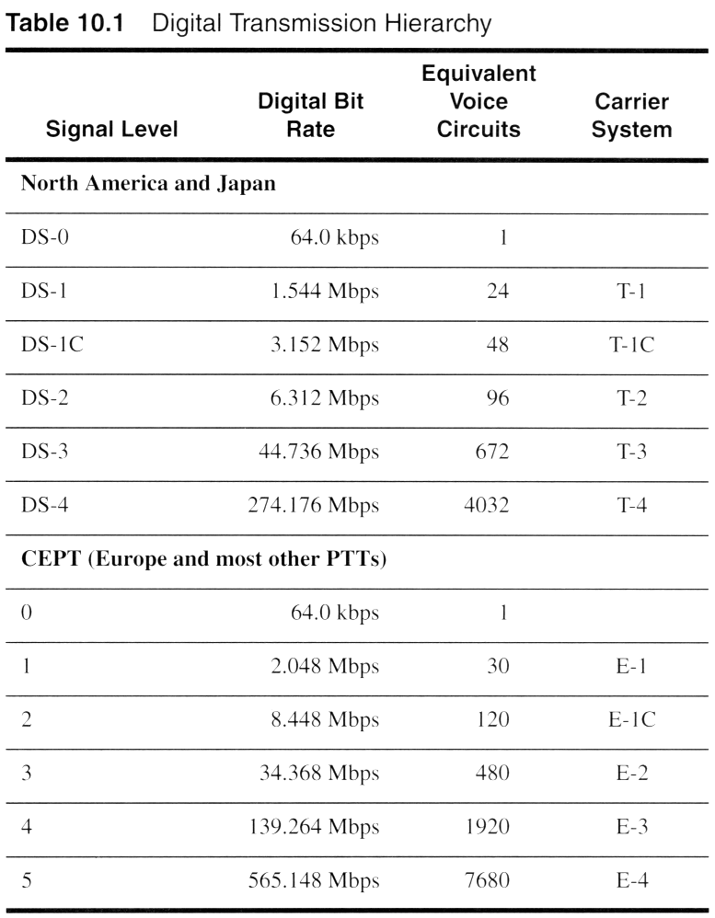
Notes:
Fig. 2.11

Slide 9
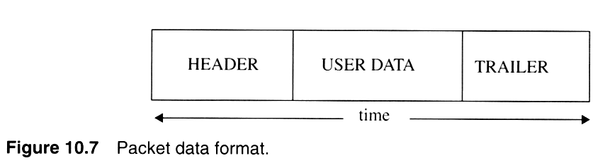

Slide 10
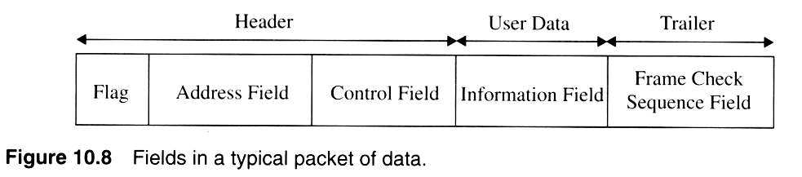
Notes:
Fig. 2.4

Slide 11
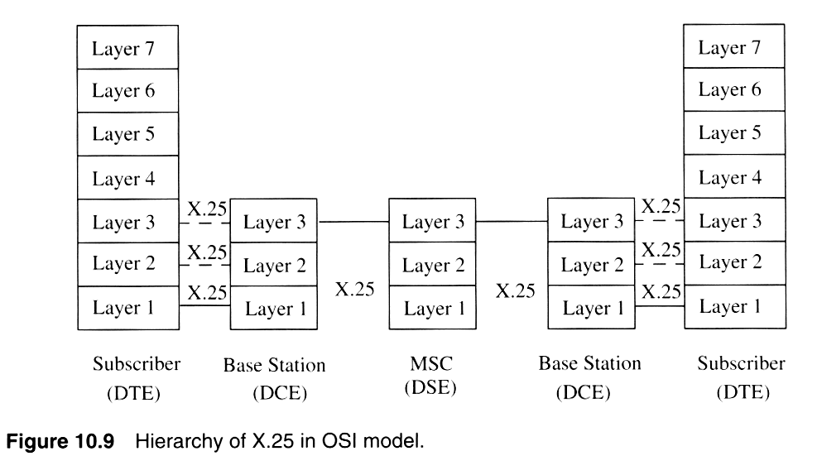
Notes:
Fig. 2.5

Slide 12
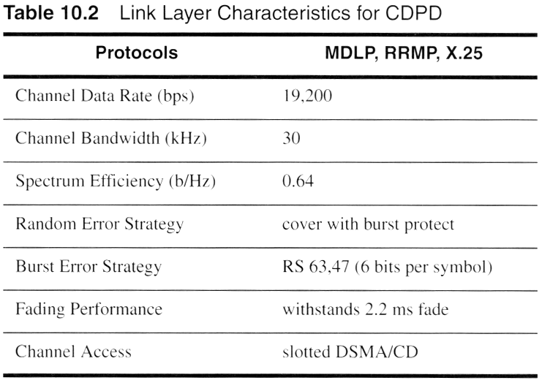
Notes:
Fig. 2.11

Slide 13
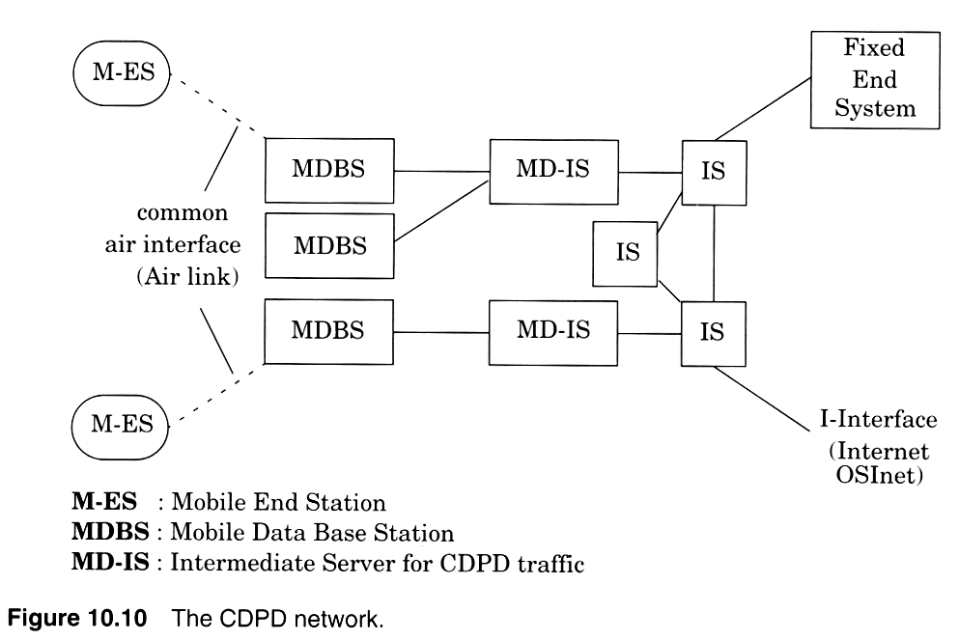
Notes:
Fig. 2.5

Slide 14
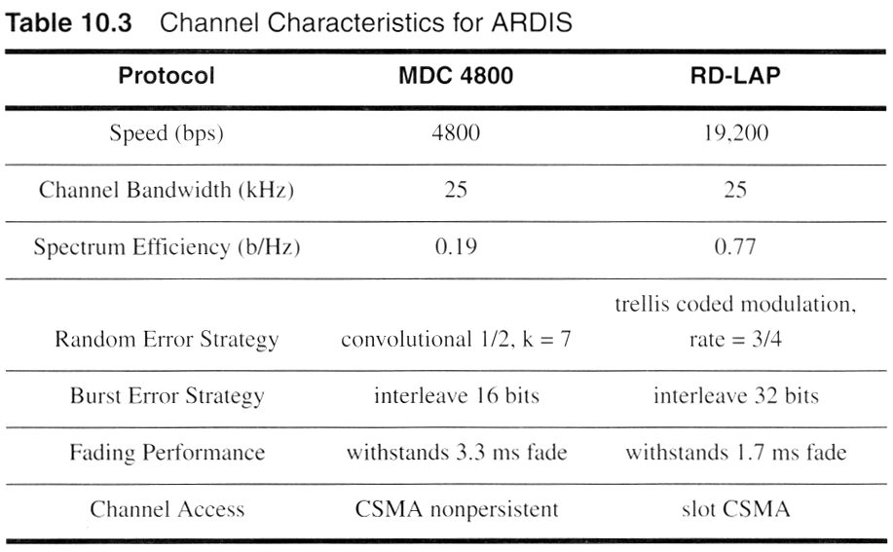
Notes:
Fig. 2.11

Slide 15
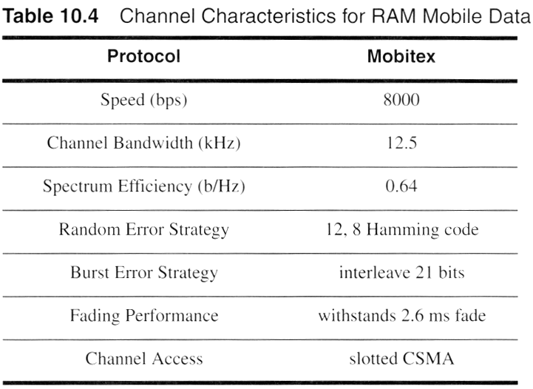
Notes:
Fig. 2.11

Slide 16
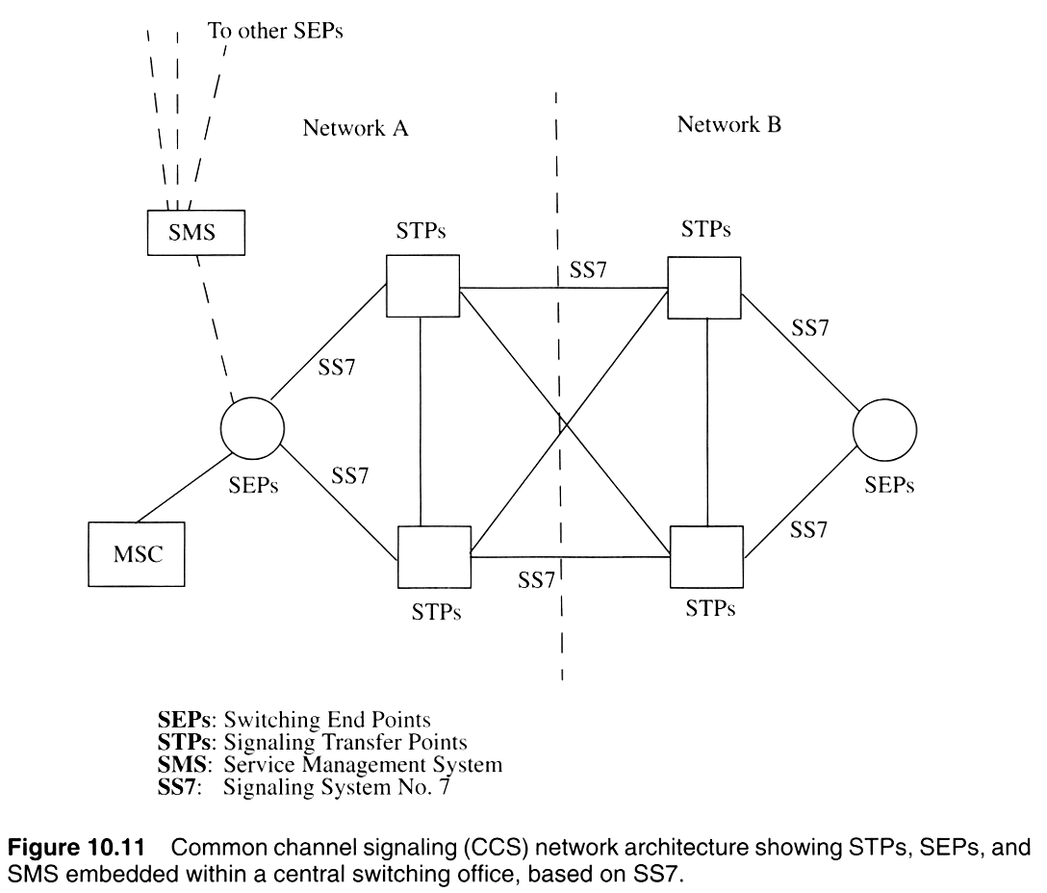
Notes:
Fig. 2.6

Slide 17
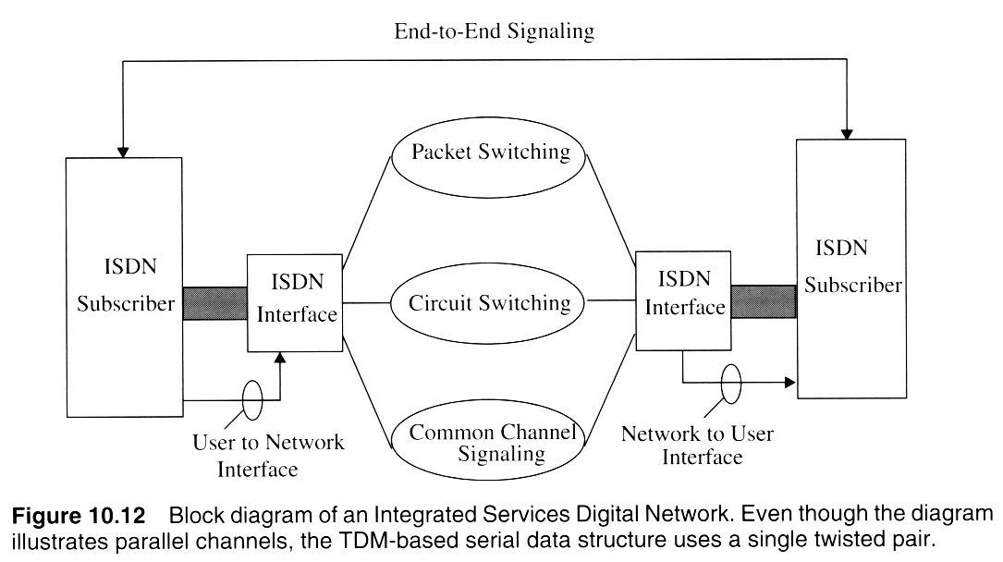
Notes:
Fig. 2.11

Slide 18
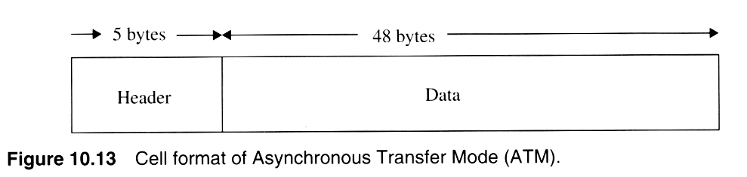
Notes:
Fig. 2.9

Slide 19
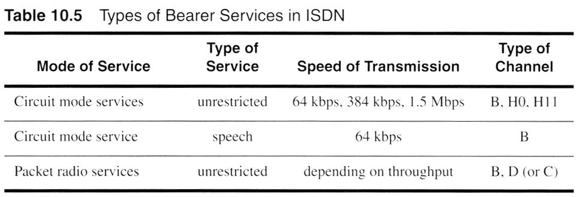
Notes:
Fig. 2.11

Slide 20
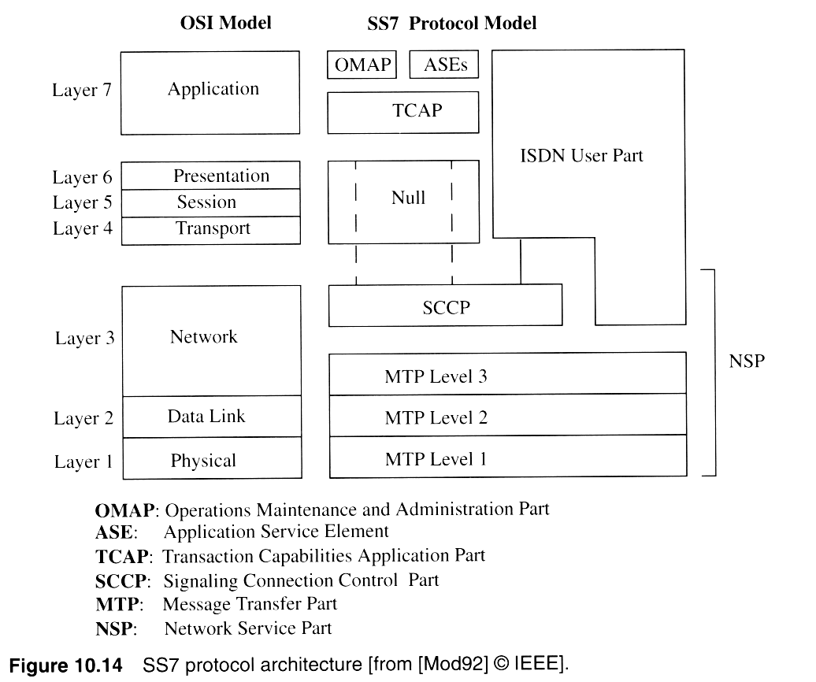
Notes:
Fig. 2.11

Slide 21
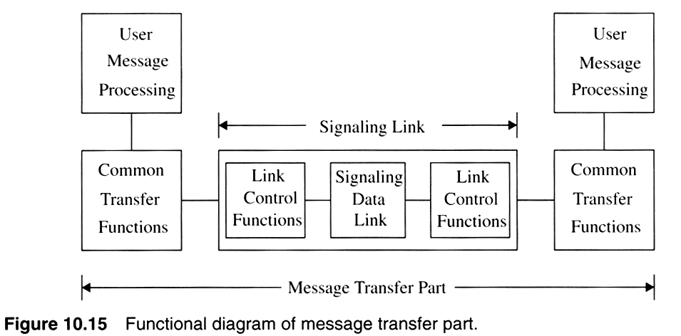
Notes:
Fig. 2.7

Slide 22
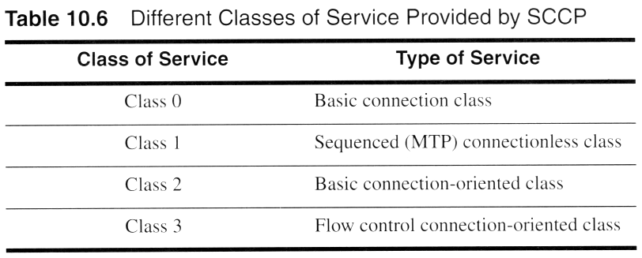
Notes:
Fig. 2.11

Slide 23
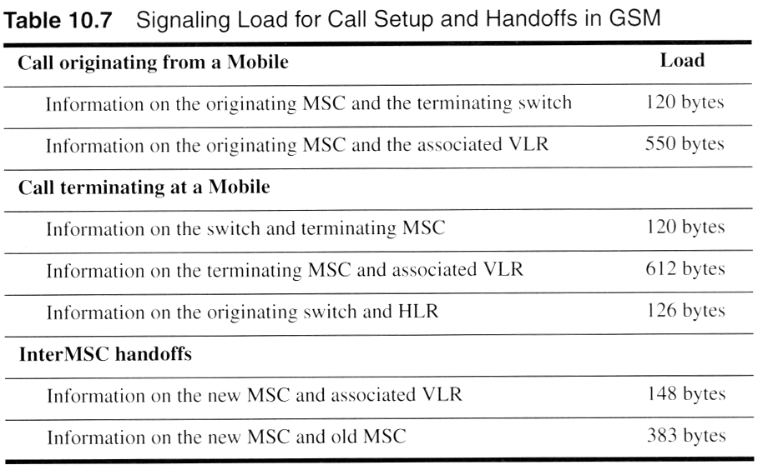
Notes:
Fig. 2.11

Slide 24
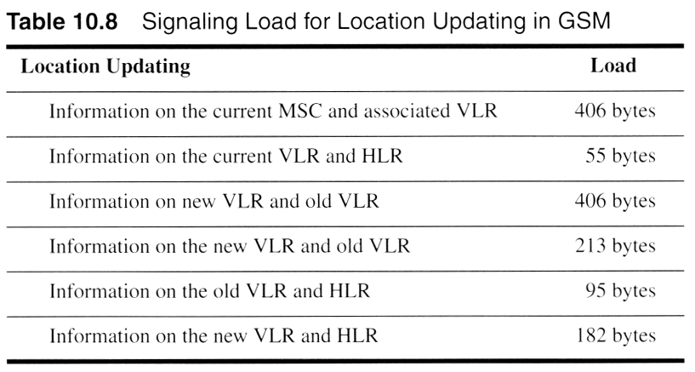
Notes:
Fig. 2.11

Slide 25
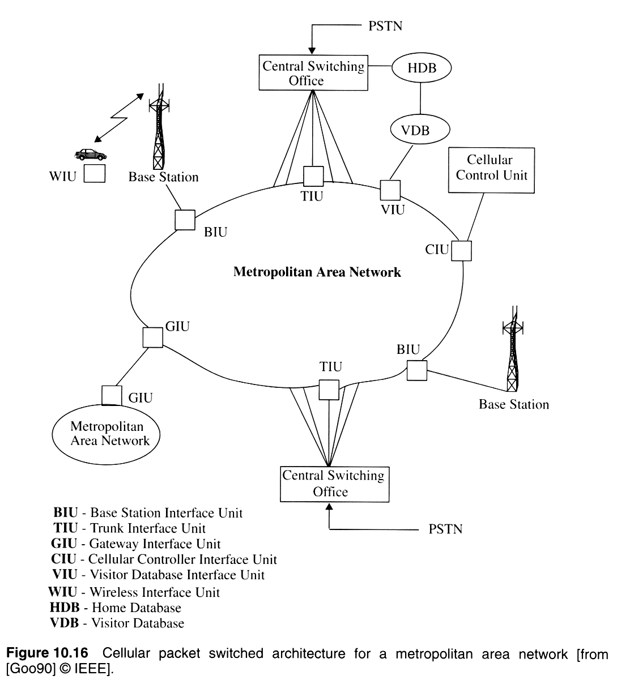
Notes:
Fig. 2.16

Slide 26
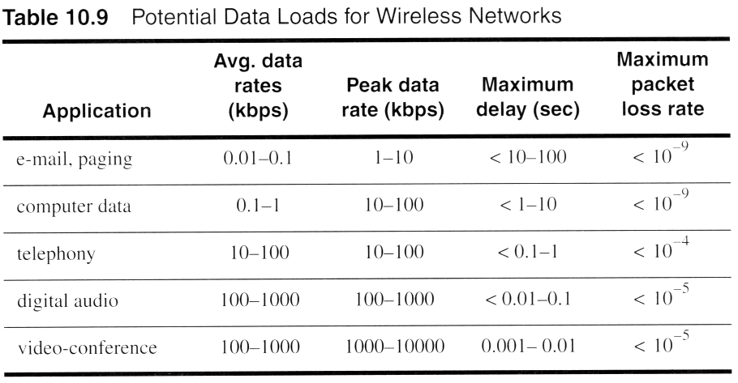
Notes:
Fig. 2.11

Slide 27
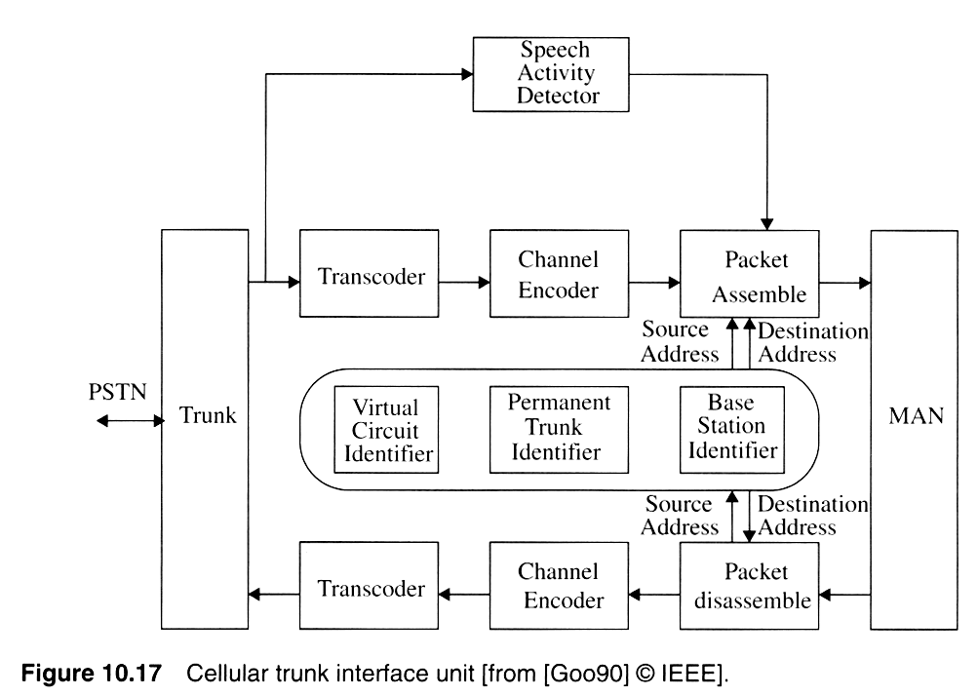
Notes:
Fig. 2.8

Slide 28
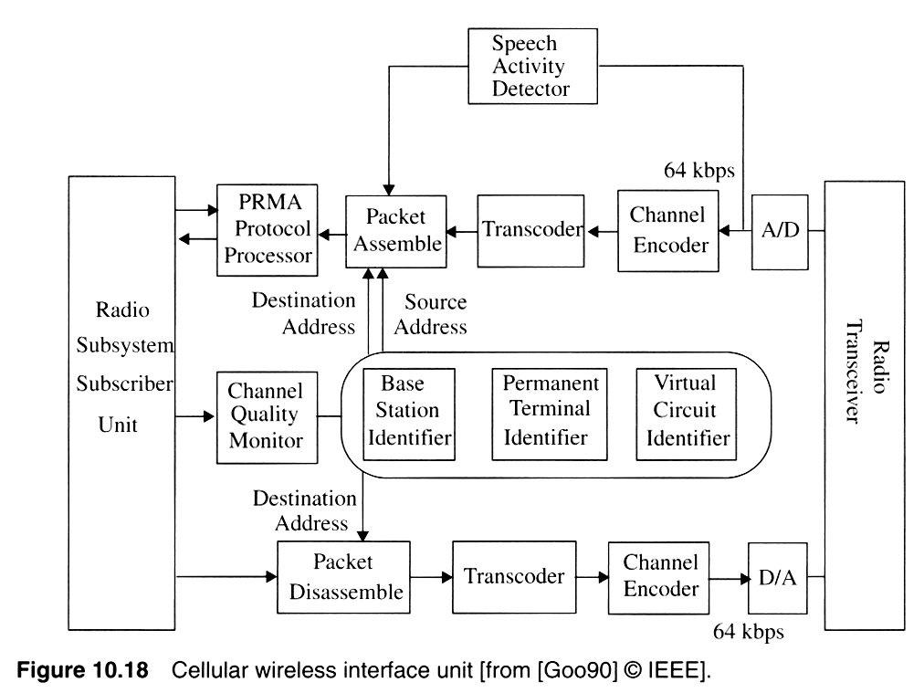
Notes:
Fig. 2.11

Slide 29
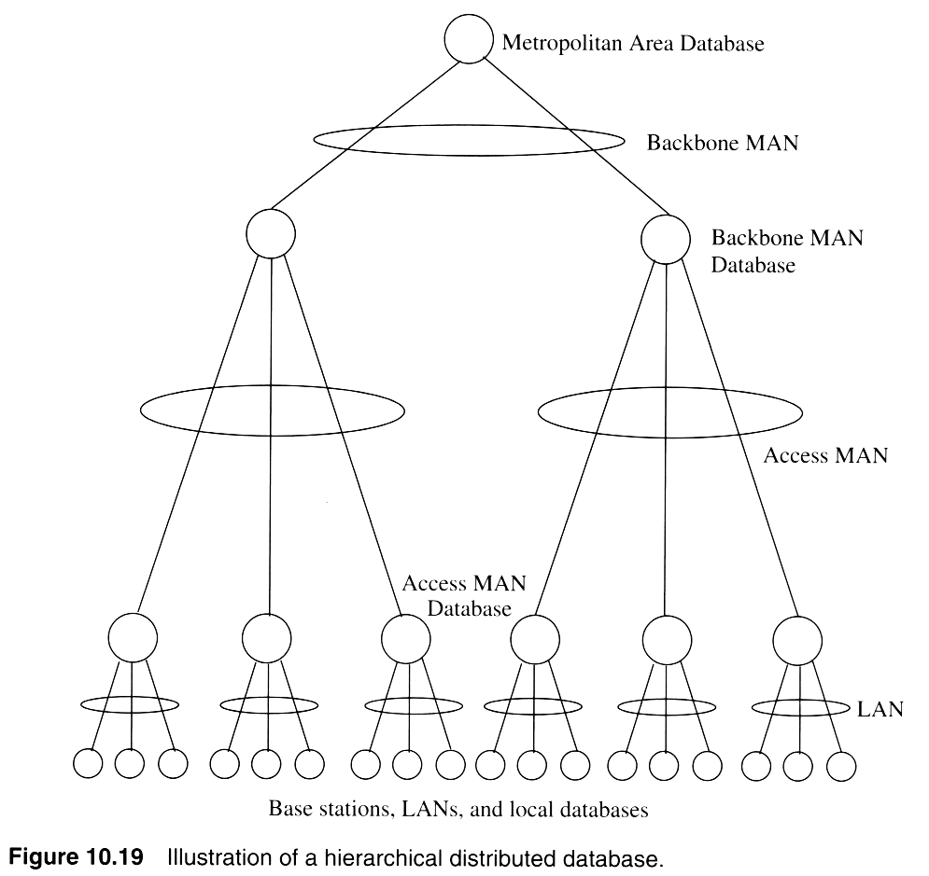
Notes:
Fig. 2.10

Slide 30
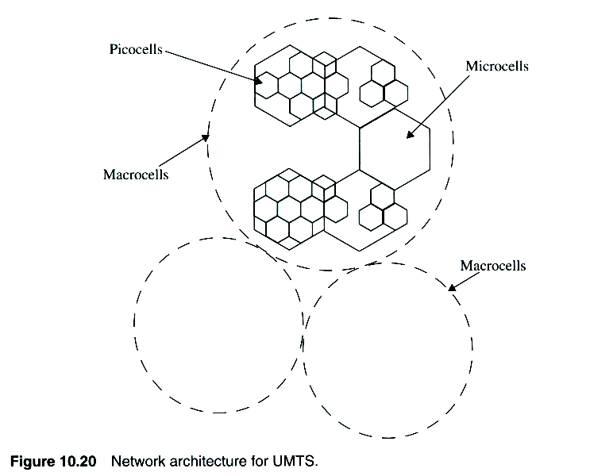
Notes:
Fig. 2.11

